Slide 1
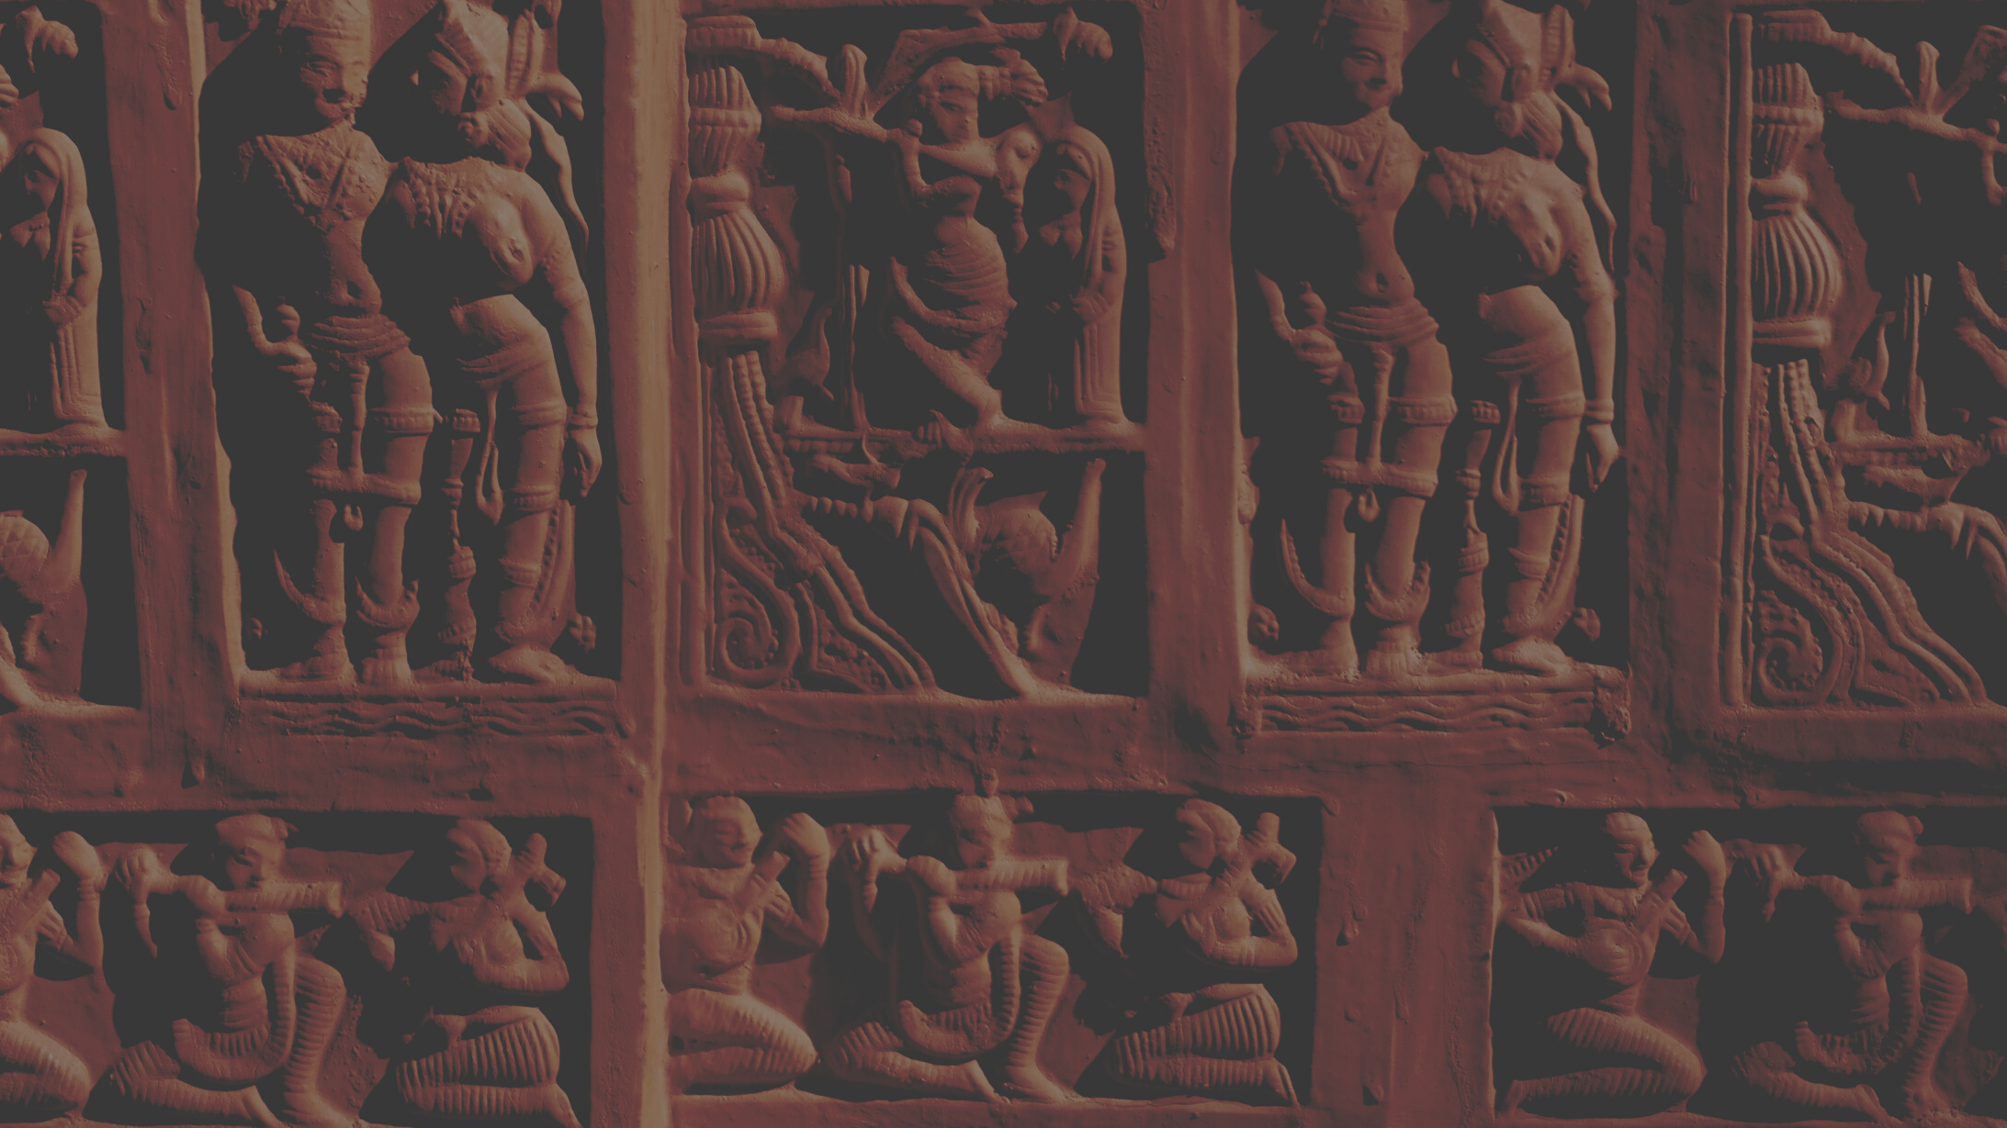
SUSHRUTA

Slide 2
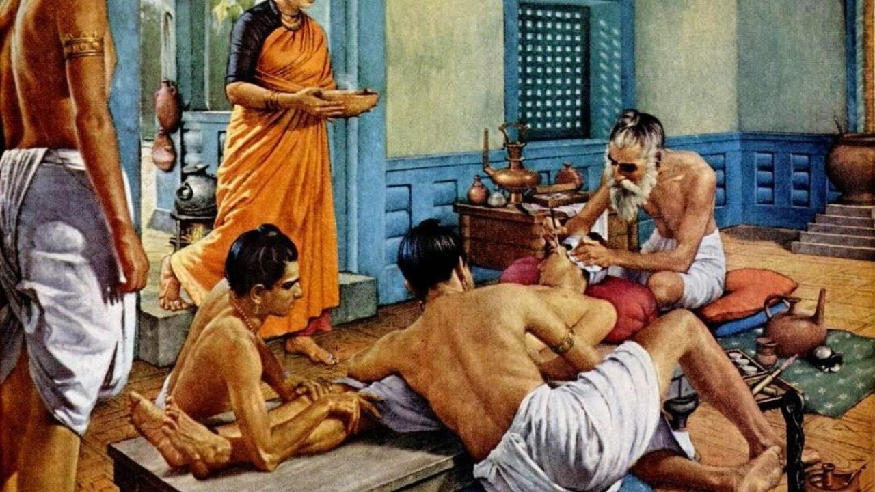

Inventor of Surgery,
First Surgeon of the World in 600 B.C.
Notes:
Did you know the first plastic surgery in the world,
was performed by an Indian surgeon whose name was Sage Sushruta?
Nearly 2600 years ago.
This Indian physician of ancient India,
also known as the father of surgery invented nearly 300 surgeries.

Slide 3
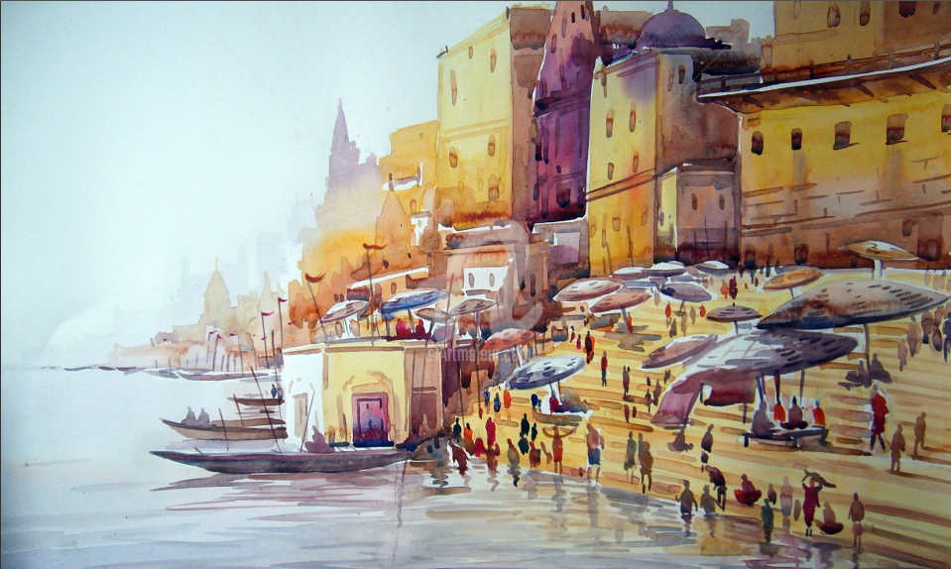
Kashi
Notes:
Sushruta lived in the ancient city of Kasi of Western India,
which today is better known as Banaras or Varanasi.

Slide 4
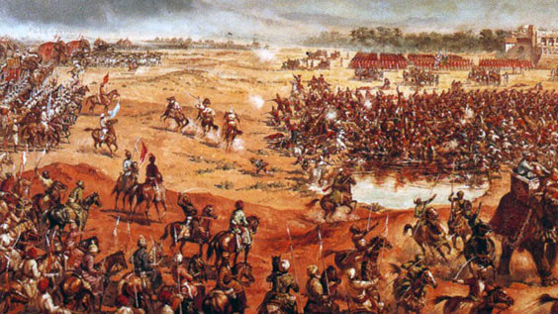
WAR
Notes:
As a physician, he treated soldiers who got injured on the battlefield.
Looking at the condition of those soldiers,
Sushruta found his inspiration for surgery.
He would fix the broken parts or injury through surgery

Slide 5
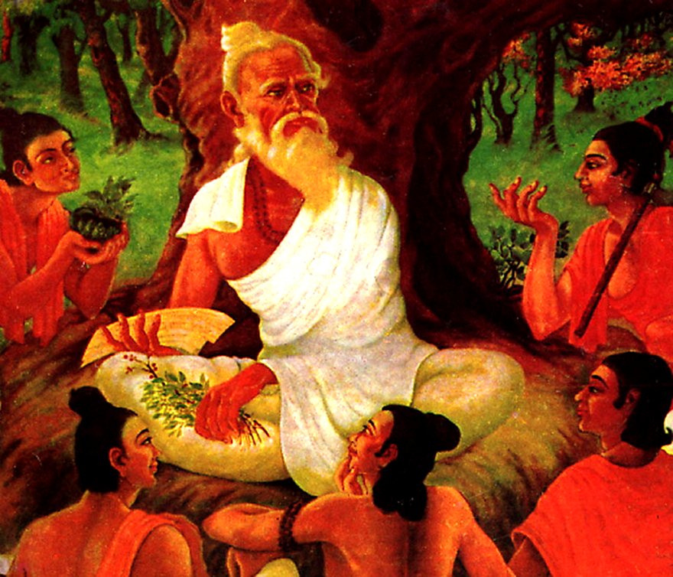
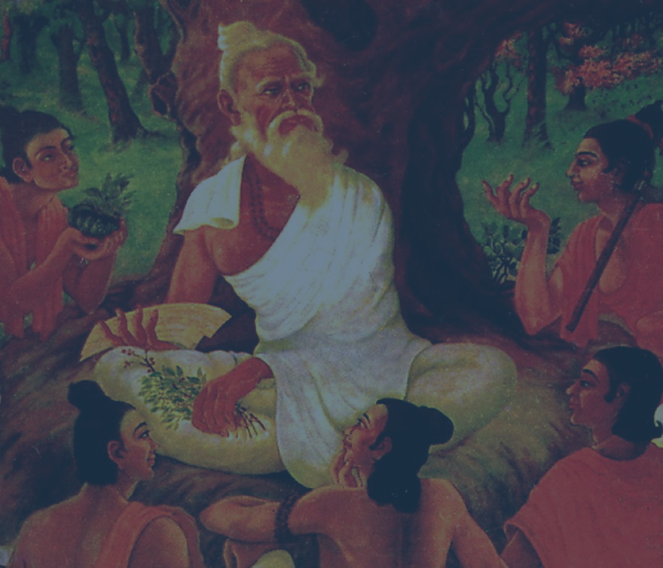
Kashiraj Divodas, the king of Kashi
Notes:
Sage Sushruta acquired his knowledge of medicine
from Kashiraj Divodas, the king of Kashi.
And he became a physician.

Slide 6
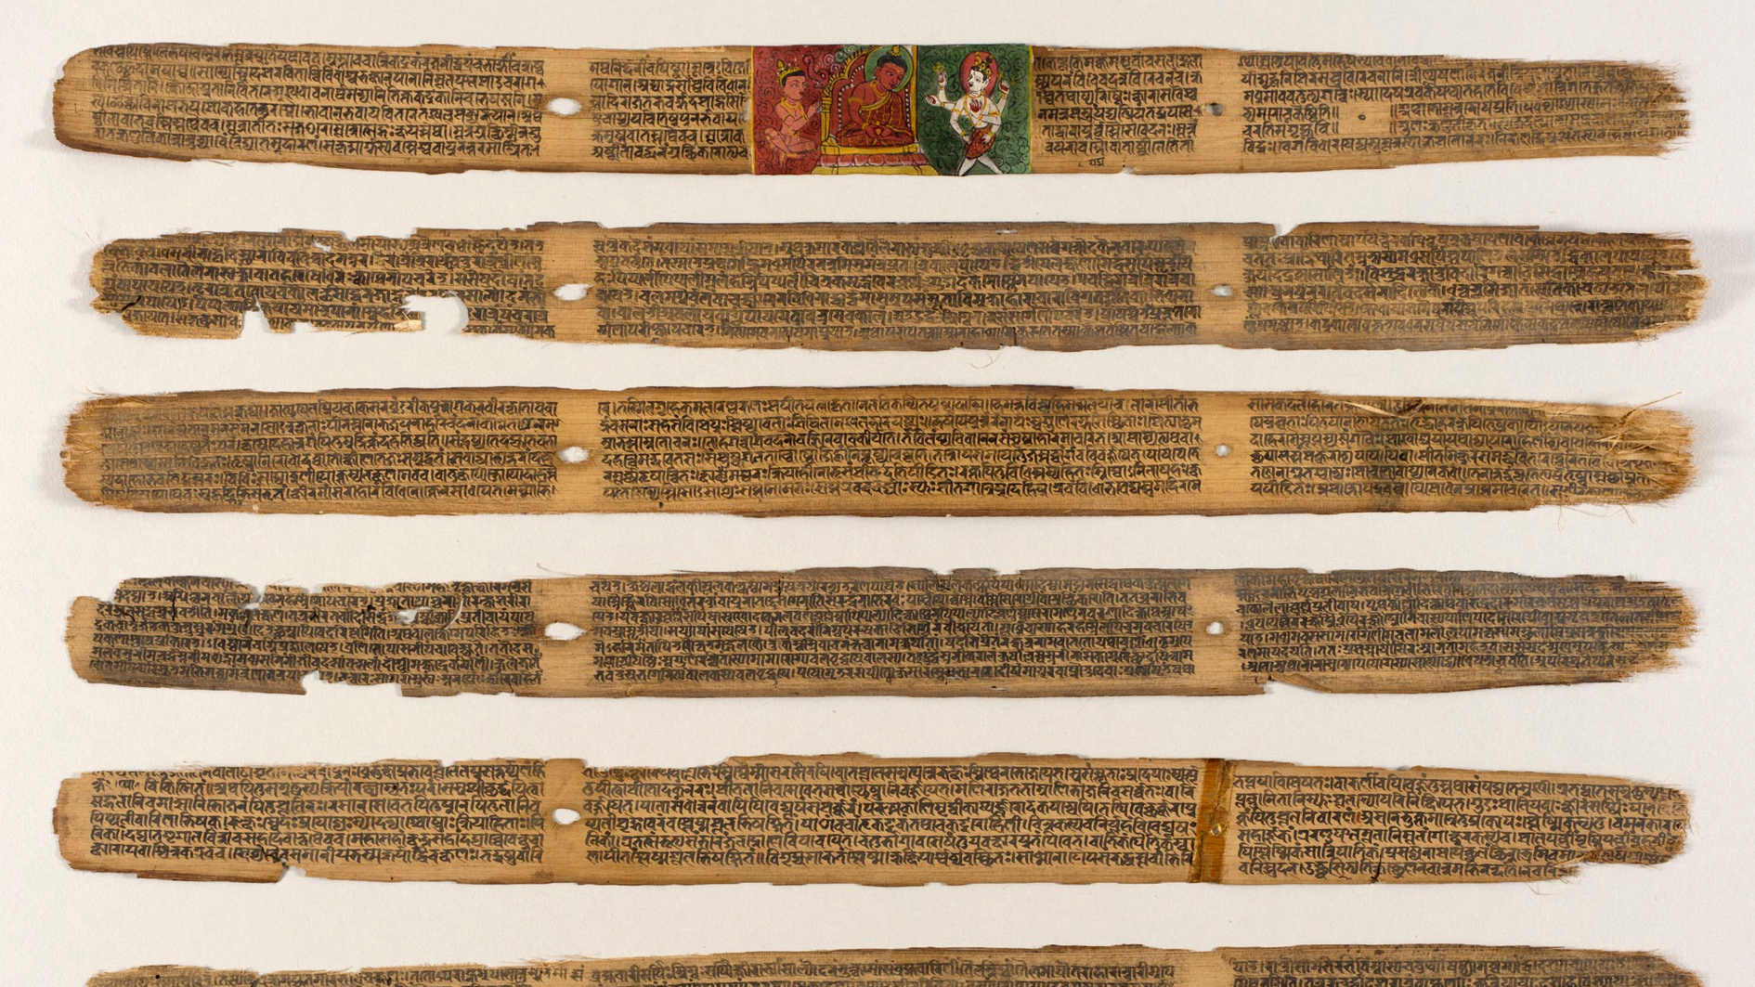
Sushruta Samhita
Notes:
Sushruta recorded his knowledge in detail in the form of a Sanskrit script,
which is also called the Sushrut Samhita.

Slide 7

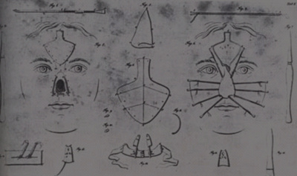
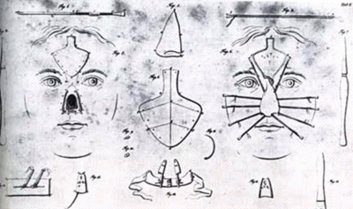
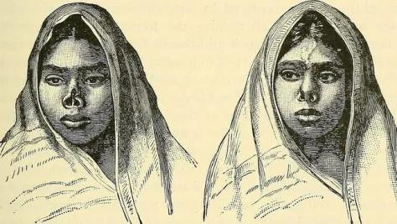
Rhinoplasty or the nose surgery
Notes:
In those days, the punishment
for any illegitimate crime was to chop off the criminal's nose.
Sushruta invented the Rhinoplasty or the nose surgery,
through which he could reconstruct the broken nose.

Slide 8
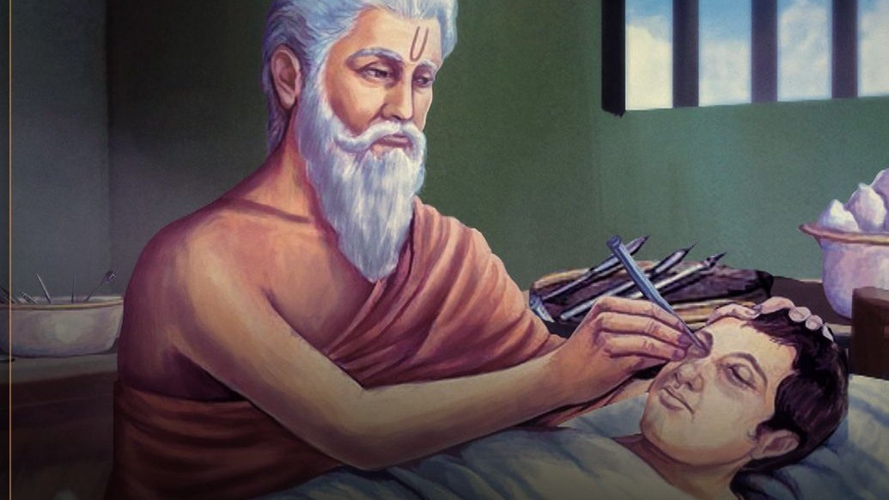
cataract surgeon
Notes:
Sushruta was also the first cataract surgeon,
who treated many eye problems.

Slide 9
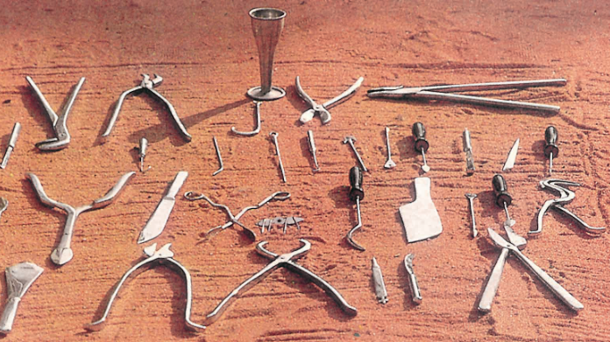
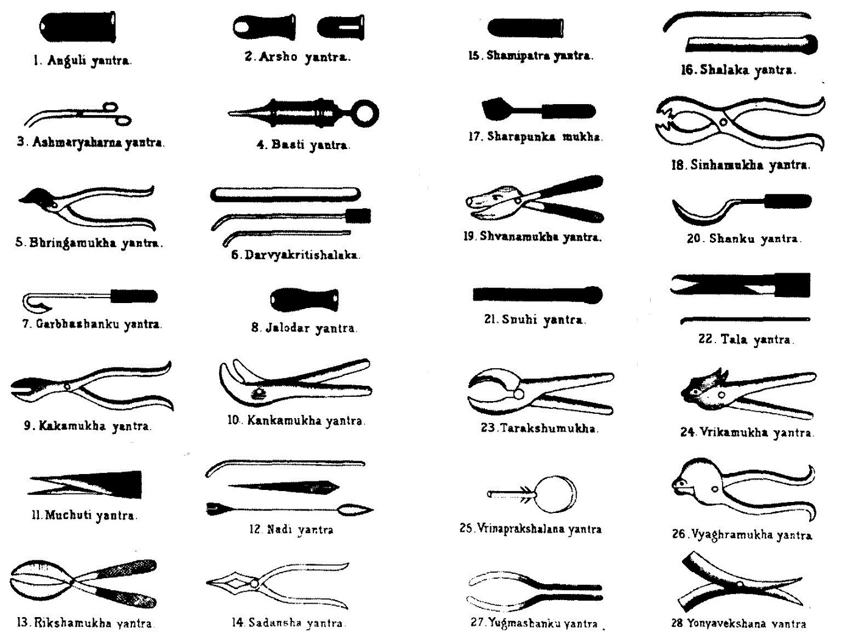
Surgical Instruments Devices
Notes:
Sushruta Samhita, in which he describes over
60 types of upkarma for treatment of wound, 120 surgical instruments and 300 surgical procedure

Slide 10
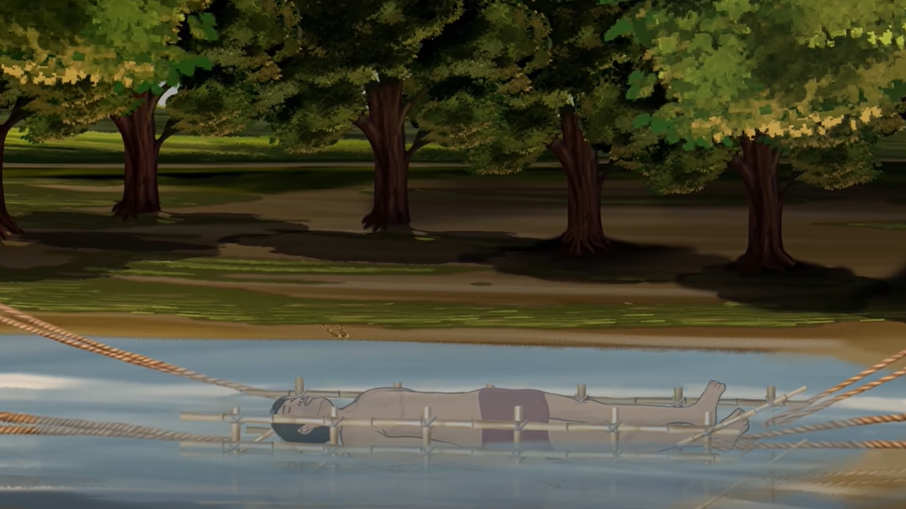
body examination
Notes:
His method of learning human anatomy was like this...
He would keep the dead body in water and let it decompose.

Slide 11
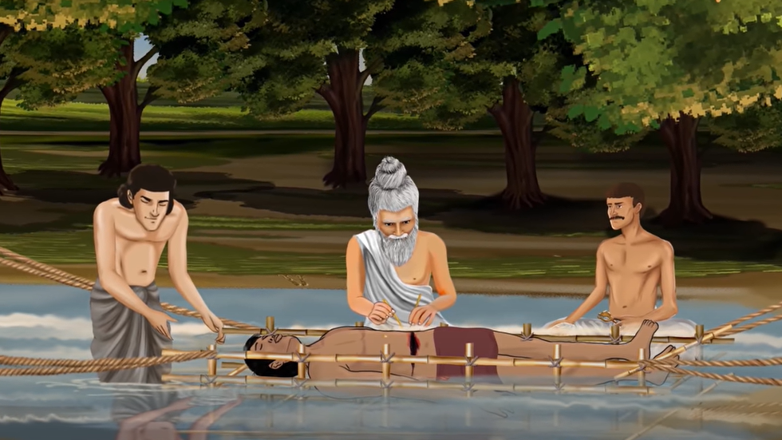
body examination
Notes:
And he would study the decomposing body with passing time.
This is how he examined the structure of the body layer by layer.

Slide 12
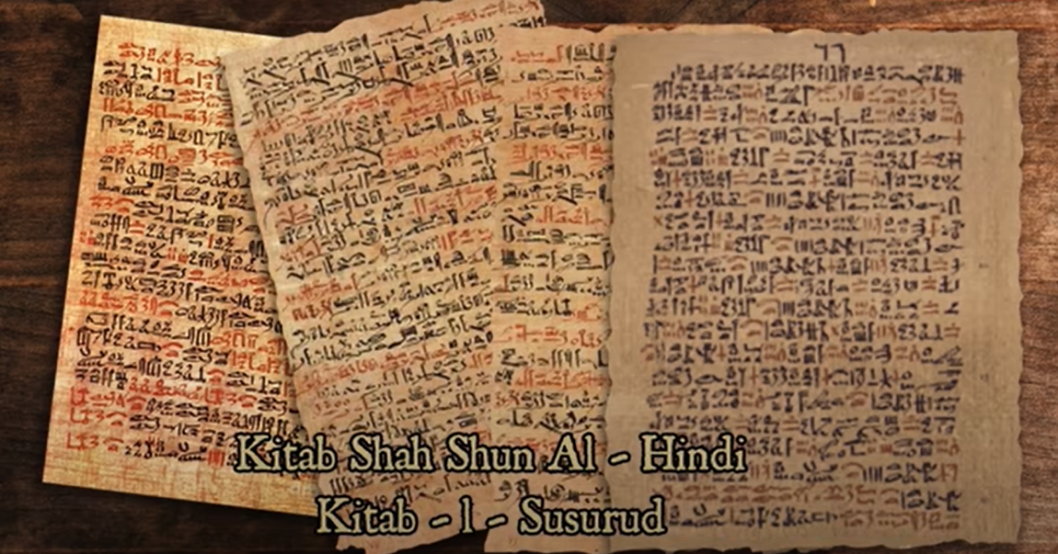
Notes:
Sushrut Samhita was written in 600 BCE.
This unique Sanskrit script about surgery and medicine,
was brought before the world in 800 AD in the form of Arab translation.
And it was called Kitab Shah Shun Al - Hindi.
And Kitab - I - Susurud.

Slide 13
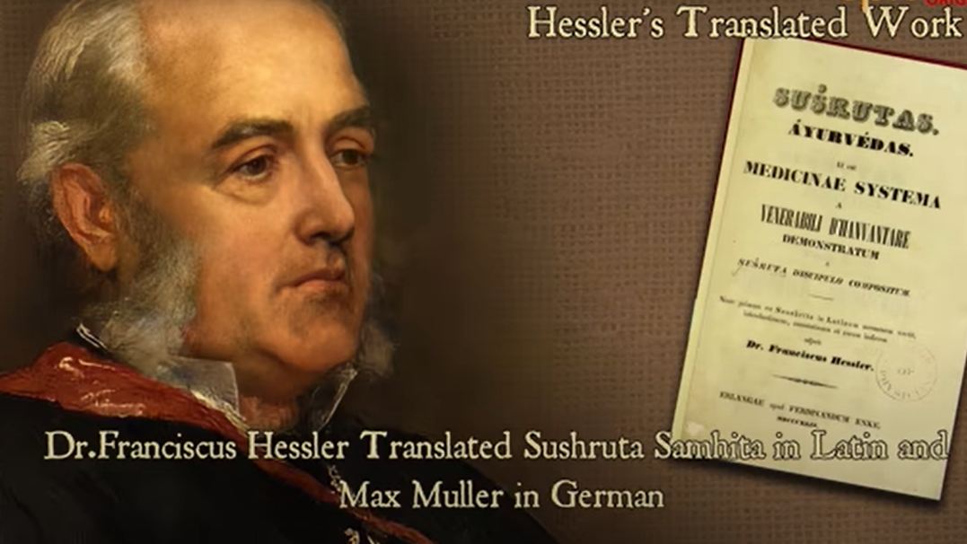
Notes:
At the beginning of the 19th century,
Hessler translated Sanskrit script into Latin,
and Muller in German.

Slide 14

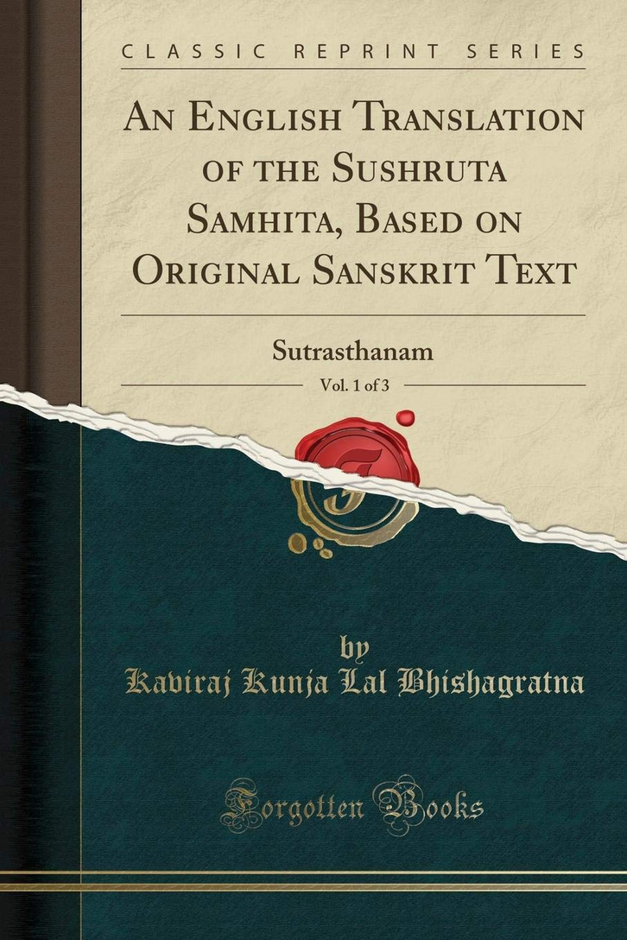
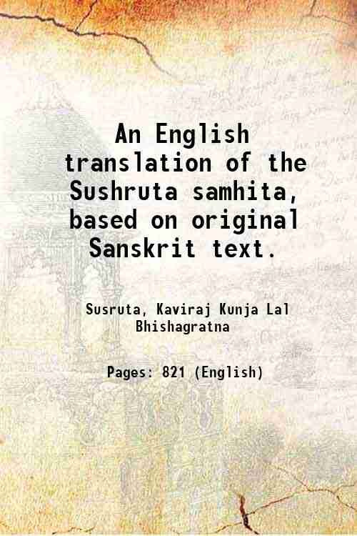

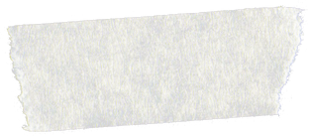
Notes:
the complete English literature was done by Kaviraj Kunja Lal Bhishagratna in the three volumes in 1907 in Calcutta.

Slide 15
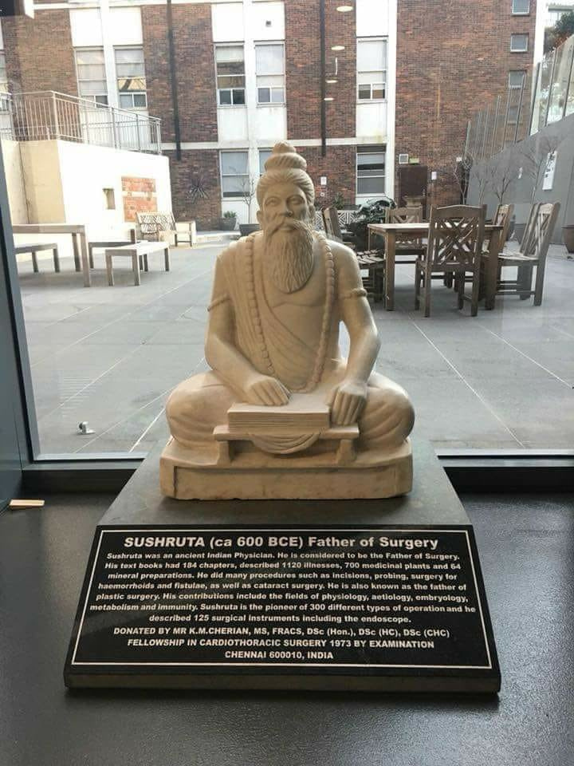

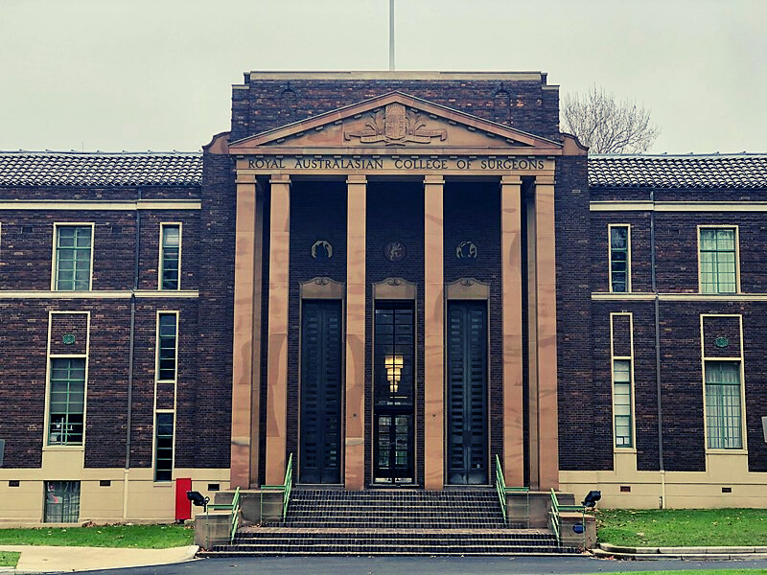
#dailyquotes | @reallygreatsite
Royal Australasian College of Surgeons
Notes:
In 2018 the Royal Australasian College of Surgeons constructed
a statue of Sushruta on their campus.
Inspired by Sushruta's incomparable knowledge,
American surgeon Allen Ripple said...
"All in All, Sushruta must be considered as
the greatest surgeon of the pre-medieval period."

